Slide 1
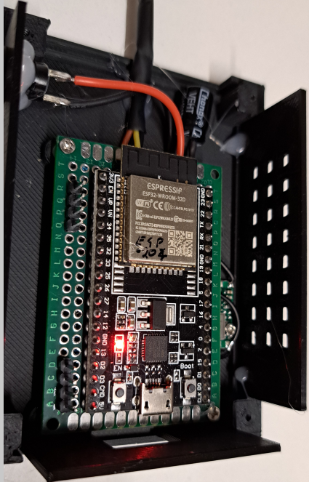
PWM
RPM
12V
GND

Slide 2
